Slide 1

Topic: Blue Prism Associate Developer Internship
Presented By:
Sahil Negi – 20SCSE1180186
Faculty Name: Program Name:

Slide 2
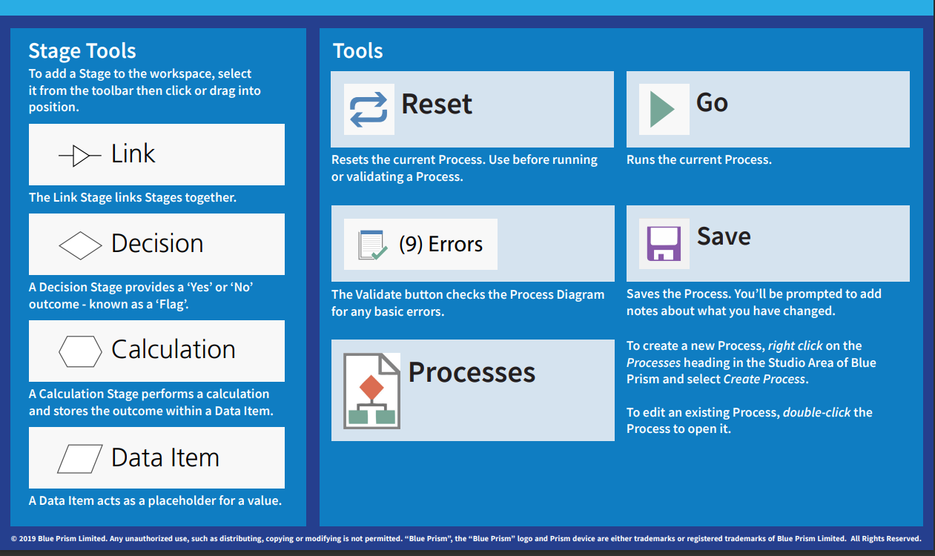
Blue Prism
Basic Tools

Slide 3
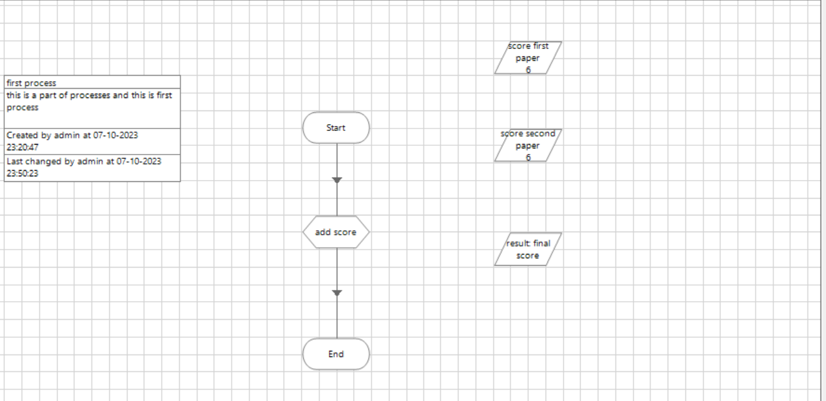
Blue Prism
First Process
Add score will Add two Value and calculate the final values

Slide 4
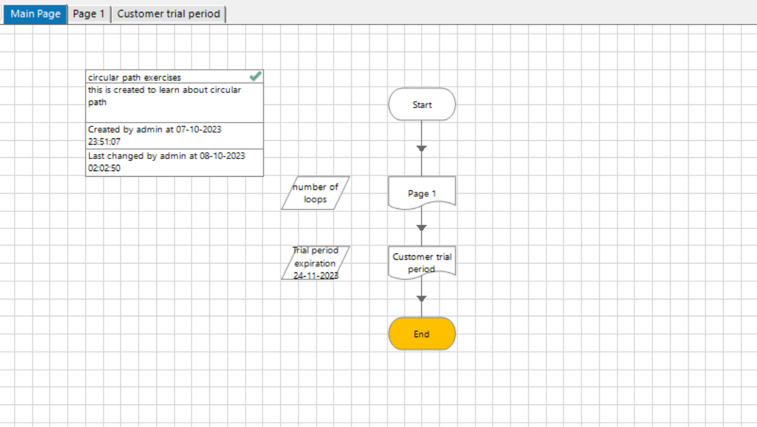
Blue Prism
Goto Another page
In Main Page :
Start Function will goto page 1 and do some desire work
then come back and then goto customer trial period page.

Slide 5
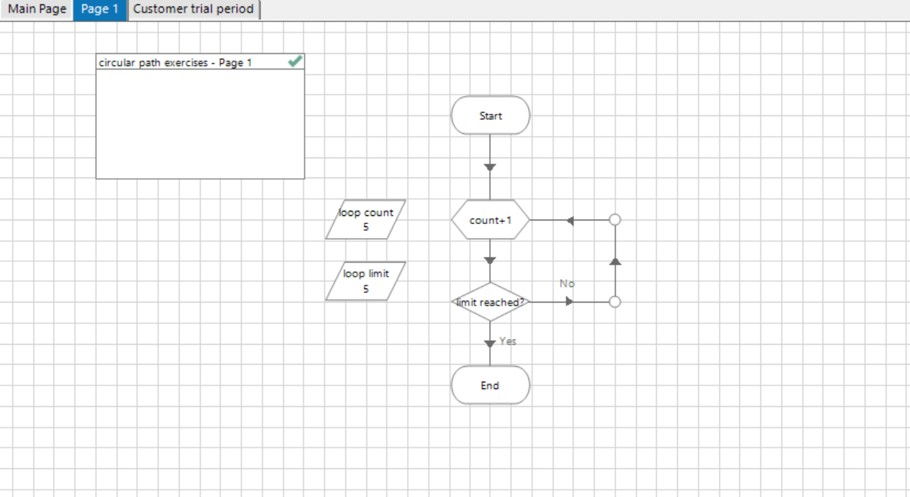
Blue Prism
Page 1

Slide 6
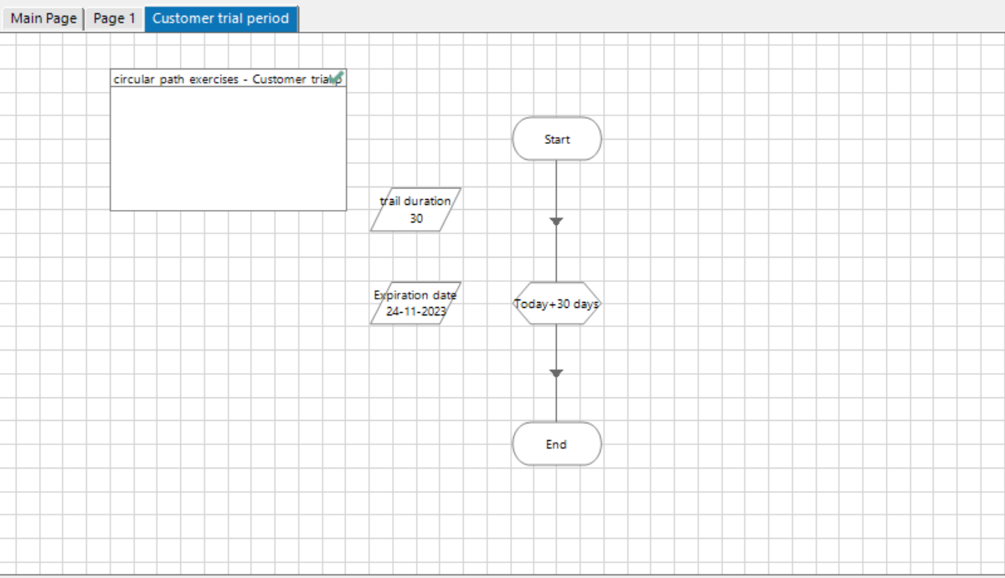
Blue Prism
Customer Trial Period

Slide 7
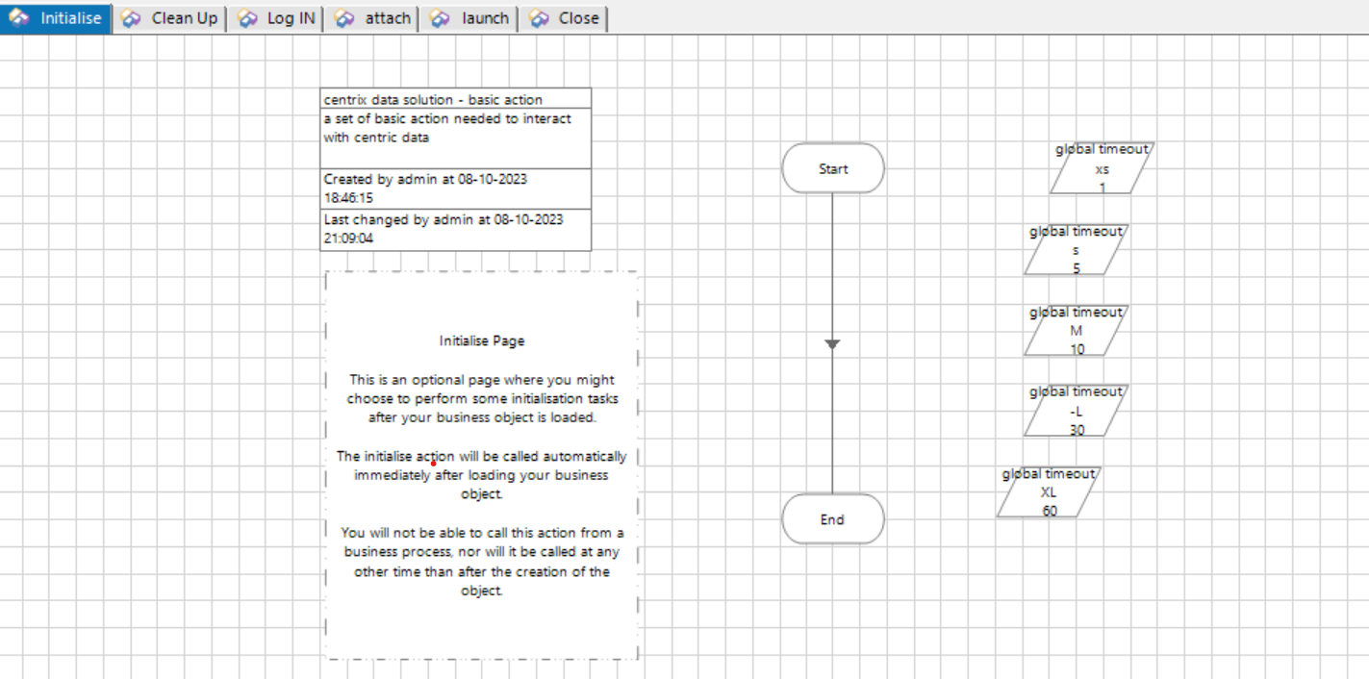
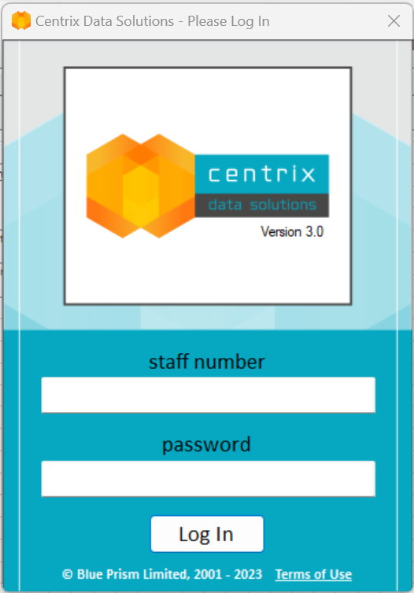
Blue Prism
Centrix Data Solution

Slide 8
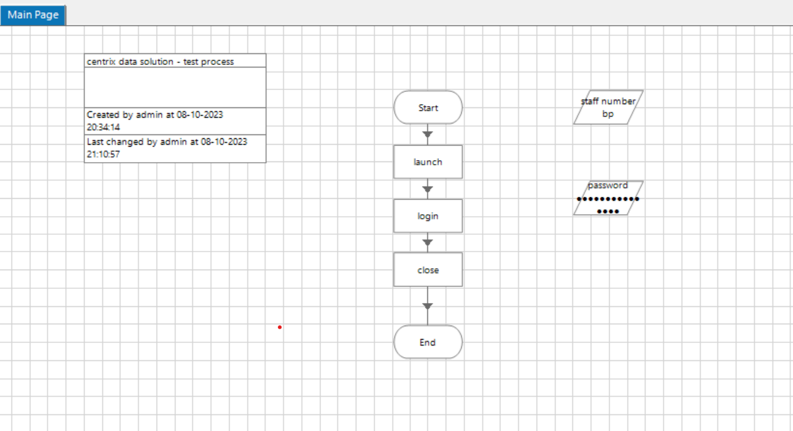
Blue Prism
Centrix Data Solution Main Page
Main Page will call launch, Login And Close function One By one

Slide 9
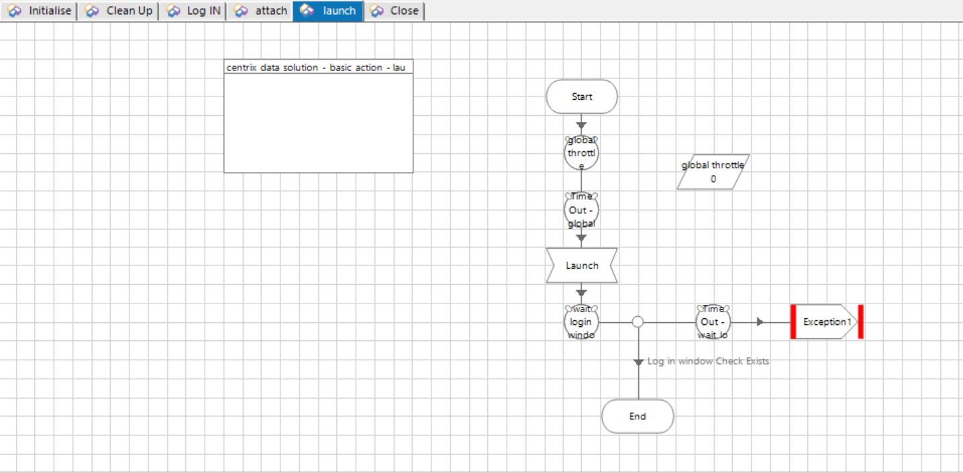
Blue Prism
Centrix Data Solution launch page
First launch Centrix Data Solution Application

Slide 10
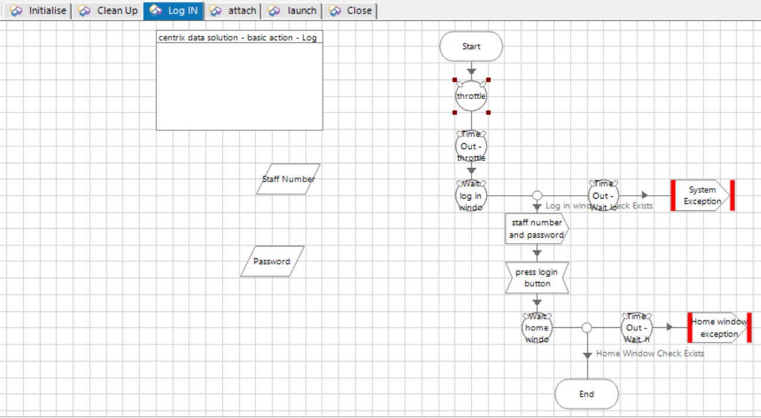
Blue Prism
Centrix Data Solution Login Page
bp
password
Second Login Centrix Data Solution Application

Slide 11
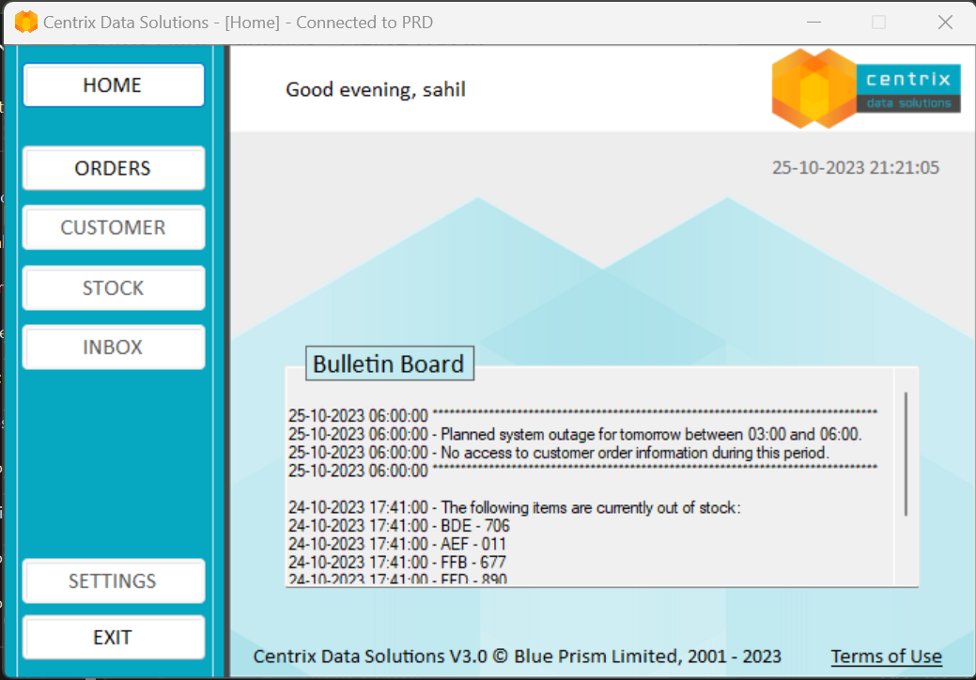
Blue Prism
Centrix Data Solution Login Successfull

Slide 12
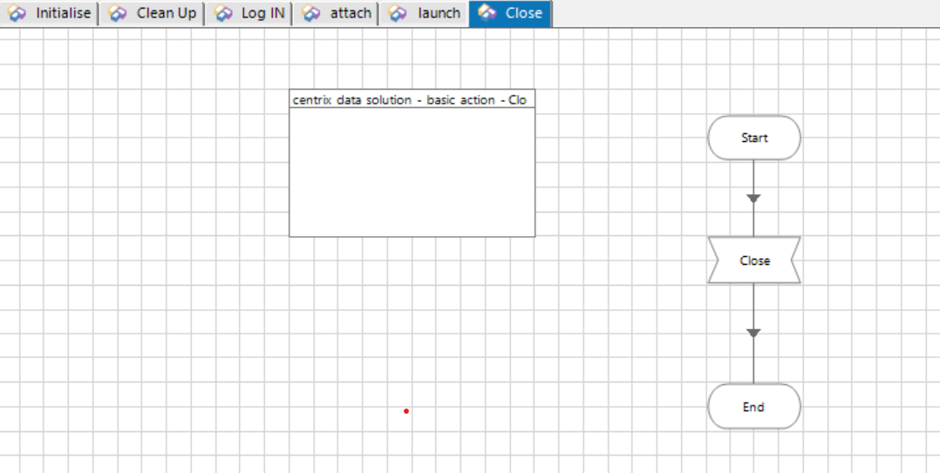
Blue Prism
Centrix Data Solution Close Operation

Slide 13
Blue Prism
Associate Developer
Thank You

